Slide 1
PROGRAMMING FOR DATA SCIENCE
PROJECT PRESENTATION
GROUP - 4

Slide 2
PROJECT DETAILS
Topic : Olist Brazilian E-Commerce Business Insights and Customer Segmentation
Group Number : 4
Group Members :
Tulasi Krishna Subhash Karanki
Ajay Kumar Choudary
Ashley Varghese John
Rishabh Amrik Sachdeva
Sanskriti Vijay

Slide 3
PROJECT CONTEXT
Olist is an online market place that connects small businesses from all over Brazil
It offers services like cataloging, sales process management, market intelligence, etc.
Merchants will list their products online and ship to the customers using Olist logistics
After the product is delivered, customer gives a review of his experience
Merchants benefit from better market presence and transparent reputation metrics
For any business, understanding its customer behavior is vital to device their strategies
This allows them to analyze the market effectively and make better decisions

Slide 4
DATA DESCRIPTION
8 different datasets have been used for the purpose of data analysis and customer segmentation
Customer data
Products data
Orders data
Geolocation data
Order items data
Payments data
Seller data
Product reviews data
– Each dataset has about 100k records from 2016 to 2018
– Each dataset is linked to another one with a primary to foreign relationship
– Since the datasets are of a Brazilian company, some of the data is in Portuguese language

Slide 5
CLEANING AND MERGING DATASETS
Use of ‘GoogleTrans’ library:
Minor data issues like missing and duplicate values
Major issue faced due to the presence of important data columns in Portuguese language
This issue has been overcome by using Googletrans library for python
Translated product category names and product reviews to English
Merging datasets:
All the datasets have been merged using Pandas library

Slide 6
USED LIBRARIES
OS – For setting working directory
Googletrans – For translating Portuguese to English
Datetime - For Processing the Timestamp data
Numpy – For numerical calculations
Pandas – For handling datasets
Matplotlib, Seaborn, mpl_toolkits – For plotting data
Sklearn – For clustering data
Yellowbrick – For plotting KElbowVisualizer
Collections – For counter functions

Slide 7
PROCESS FLOW
Import libraries
Data importing
Data cleaning and merging
Data insights
Analyzing the customer behavior
Customer segmentation
Recommend business strategies

Slide 8
BUSINESS DATA INSIGHTS

Slide 9
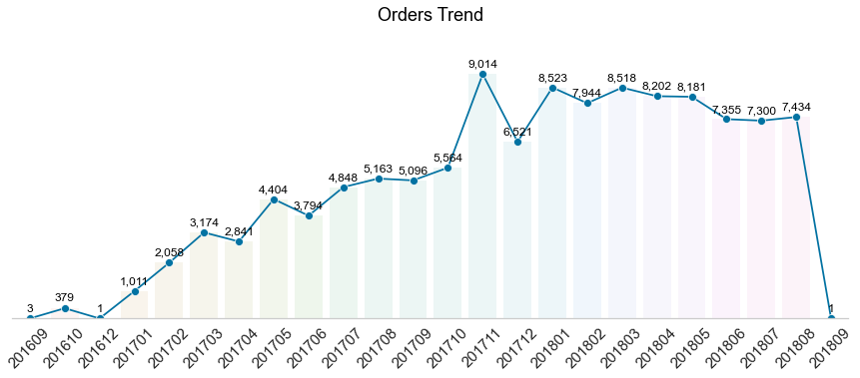
TREND OF ORDERS
Time Series depiction of orders
Insights:
There is a spike in the number of orders, over 9000 during the month of November 2017
Black Friday on November 24th, 2017 had the highest number of sales with 1231 orders on that single day itself
Referring to the month-over-month statistics, Olist has a greatly improved its business over a period of time

Slide 10
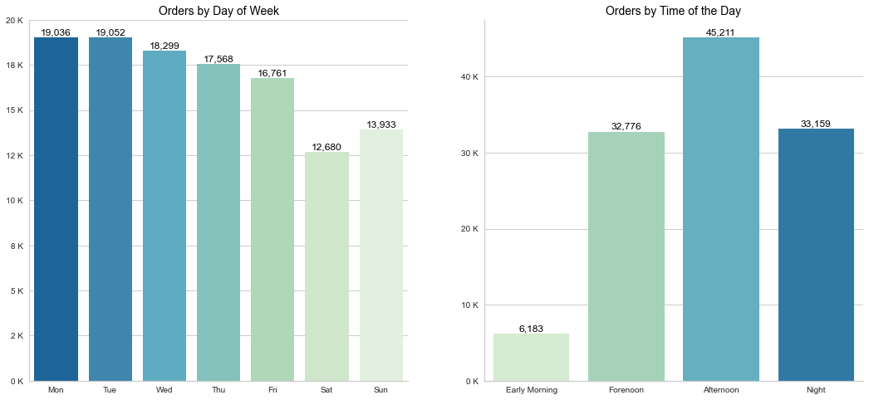
ORDERS BY DAY OF WEEK AND TIME OF DAY
Insights:
From the above bar graph, the number of orders have a downward trend towards the weekend, but a slight raise on Sunday
Both Monday and Tuesday have nearly same number of orders
Most of the customers placed order during the afternoons
Fairly similar number of orders are placed during the mornings(Forenoons) and nights

Slide 11
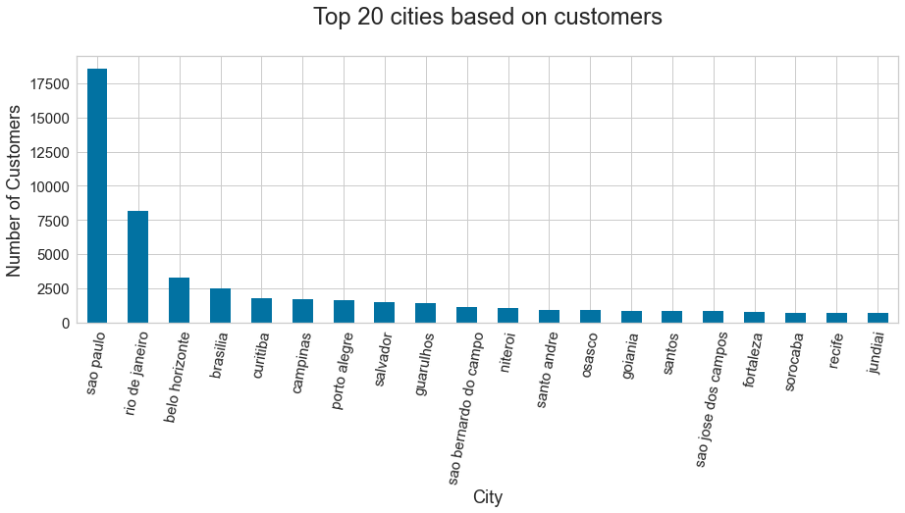
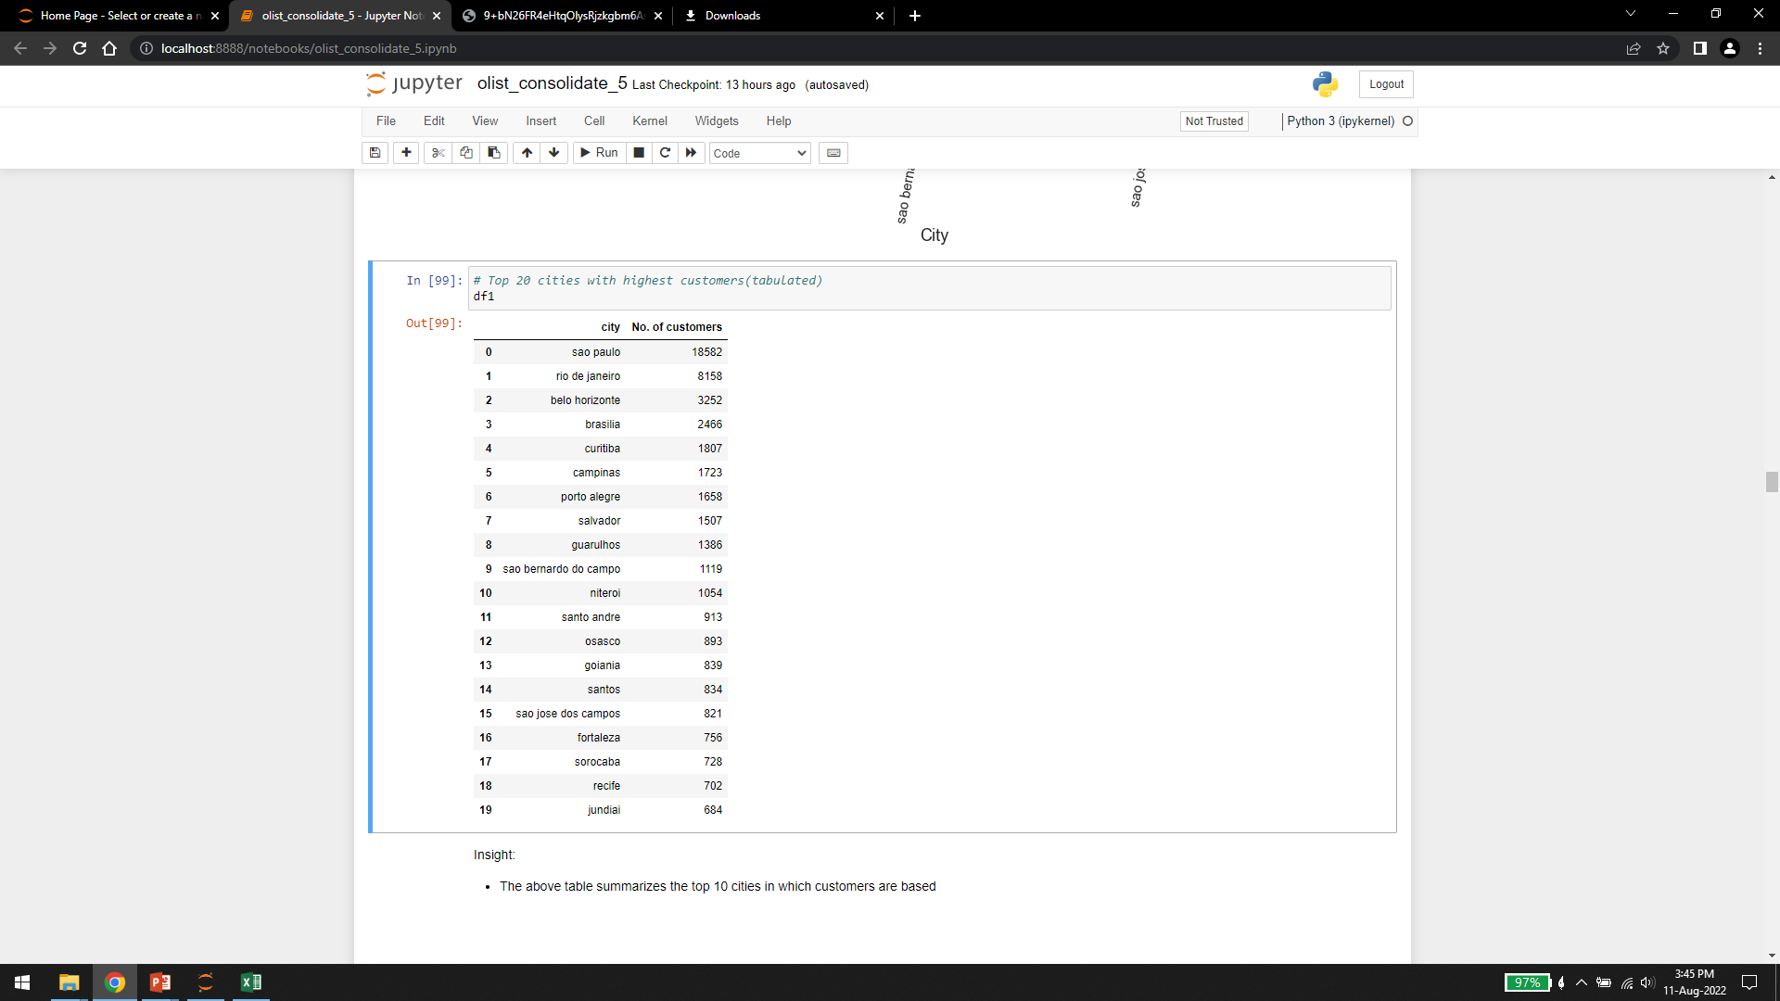
TOP 20 CITIES BASED ON CUSTOMERS

Slide 12
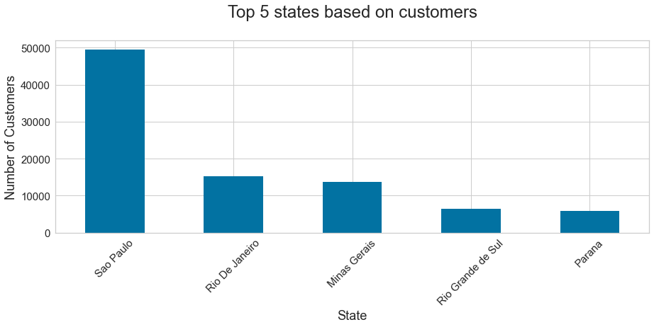
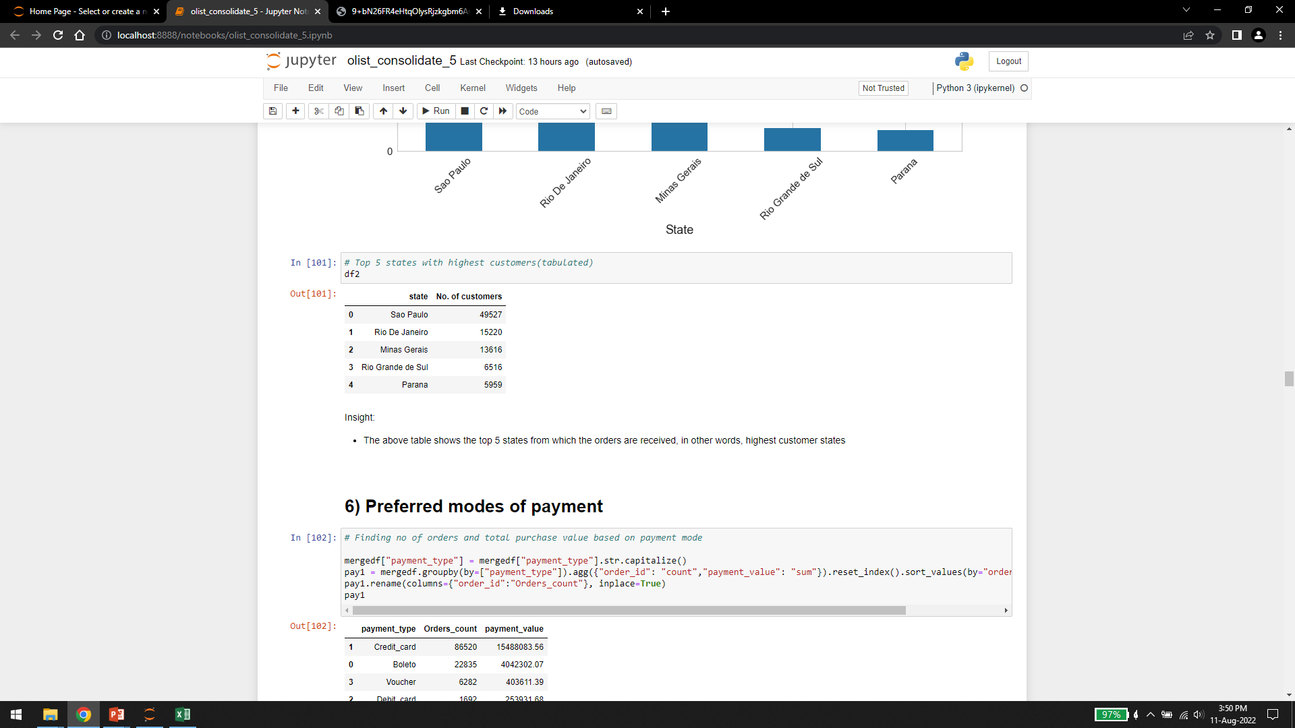
TOP 5 STATES BASED ON CUSTOMERS

Slide 13
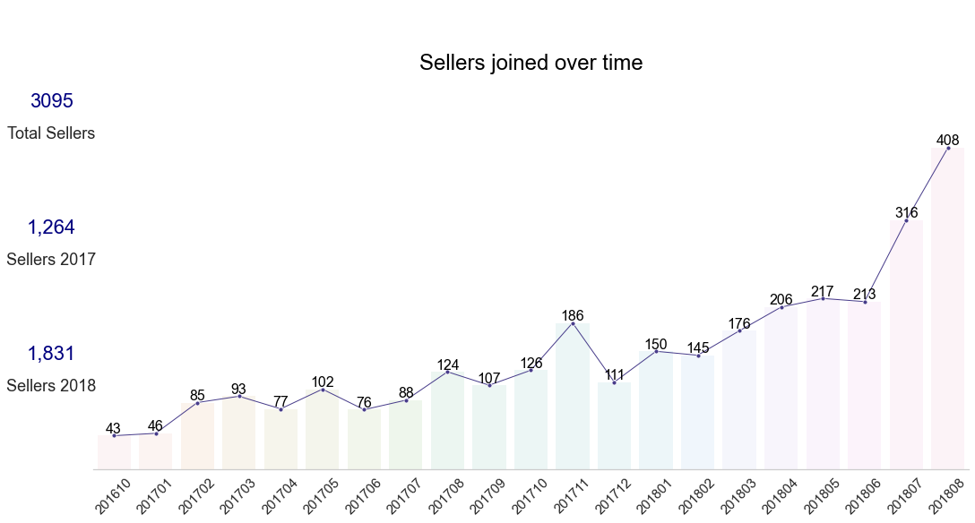
TREND OF SELLERS JOINING OLIST
Time Series depiction of sellers joining Olist
Insights:
With the rise in popularity of the online shopping, more and more number of retailers moved to online mode of business
From 2016 to 2018, there is a steady growth in the number of sellers who registered themselves on this online market platform

Slide 14
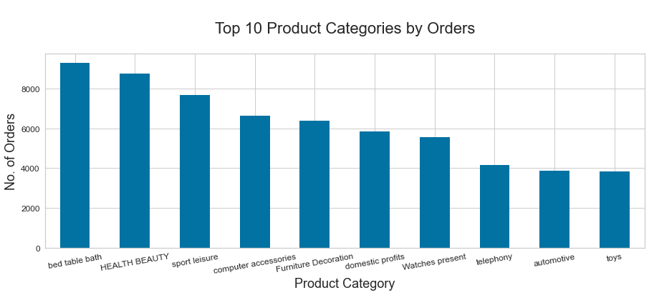
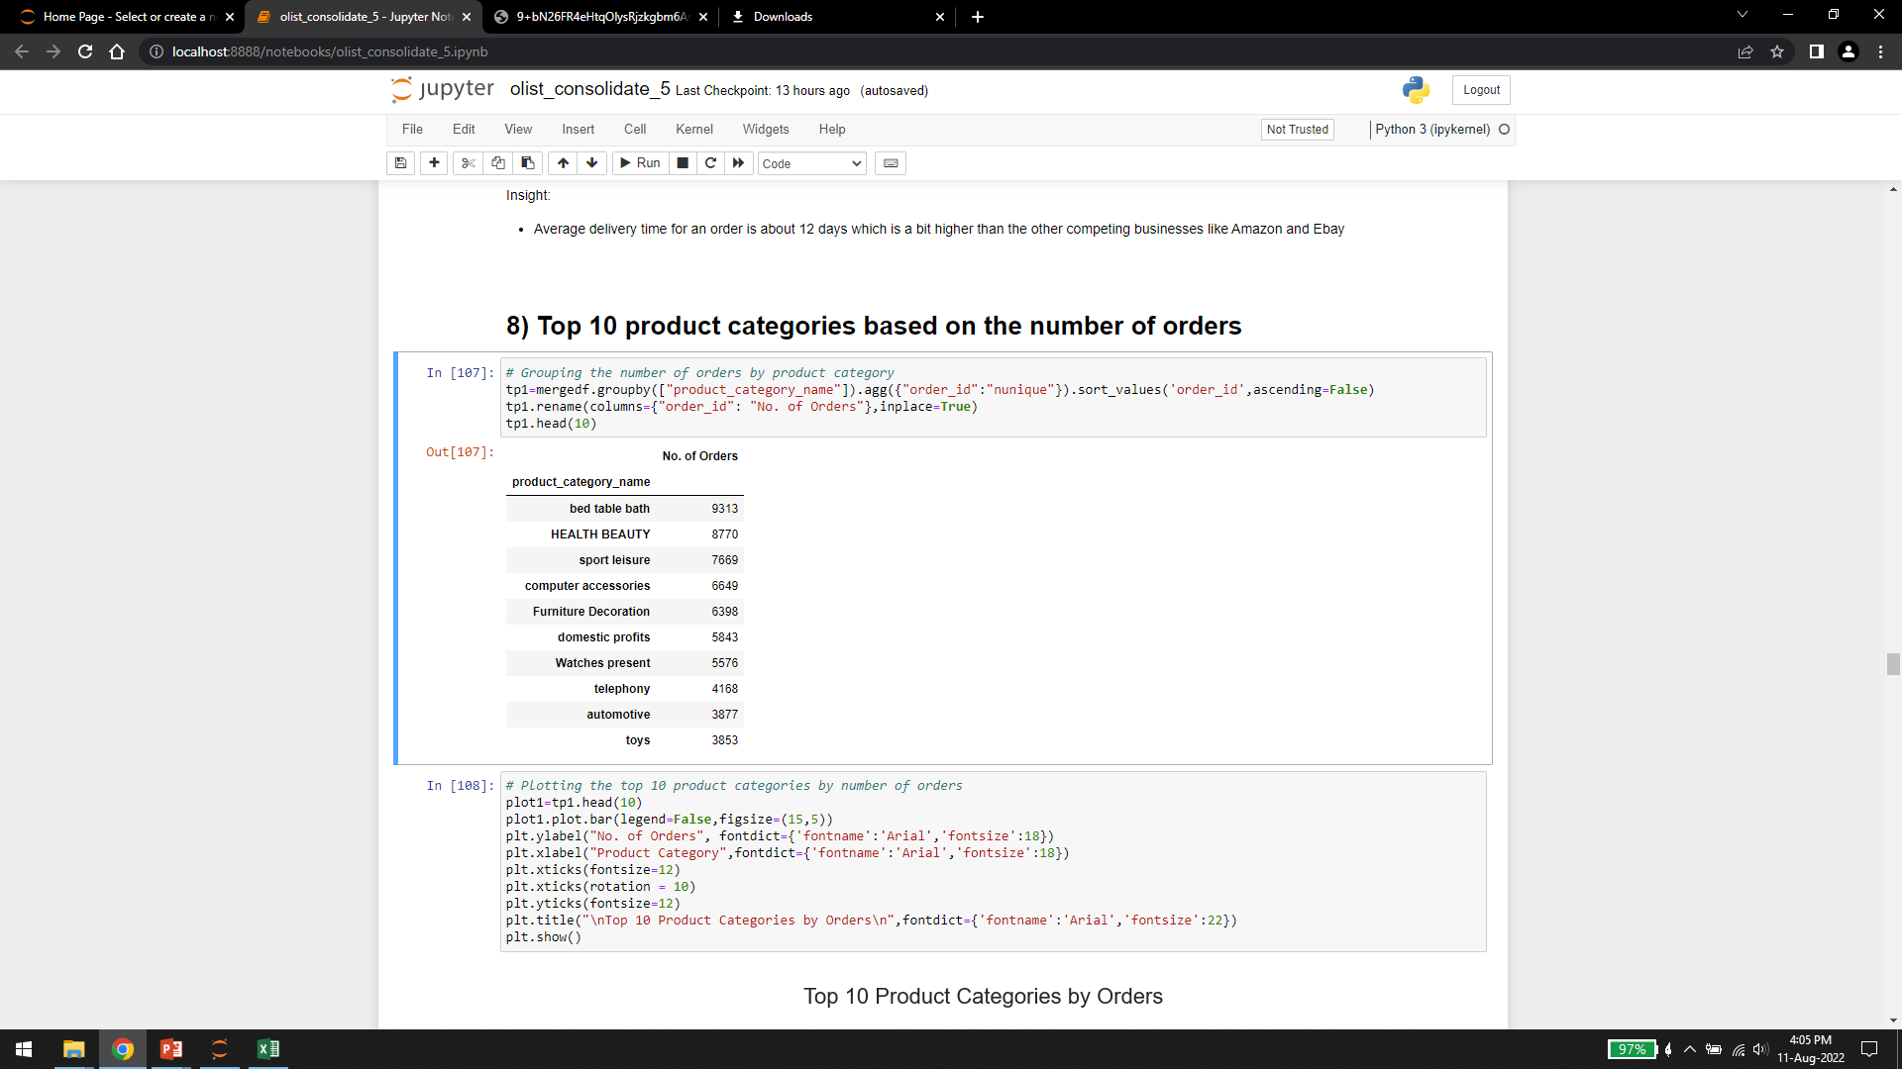
TOP 10 PRODUCT CATEGORIES BY ORDERS

Slide 15
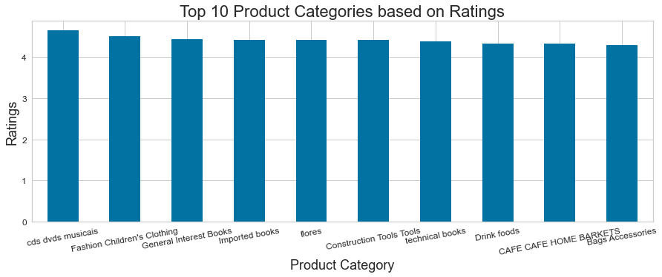
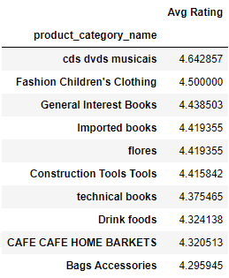
TOP 10 PRODUCT CATEGORIES BY RATINGS

Slide 16
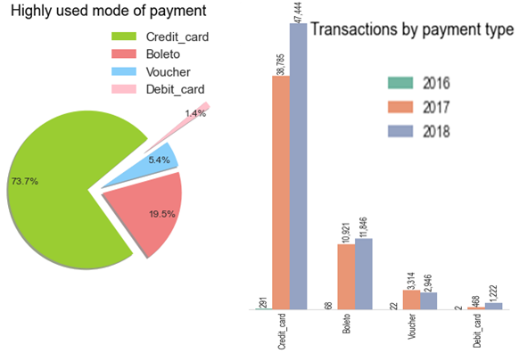
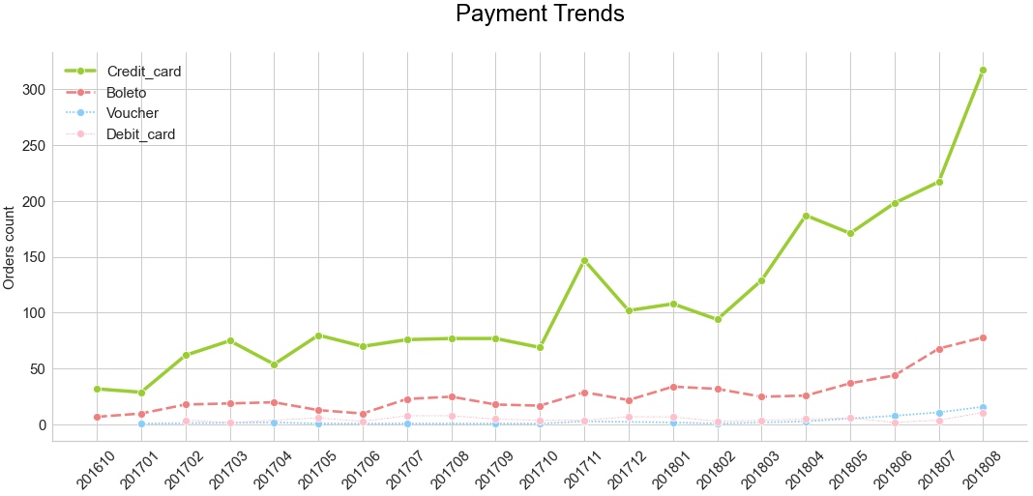
PREFERRED MODES OF PAYMENT
*Horizontal bar plot rotated to vertical plot to fit the space on the slide
Insights:
From the pie chart, it can be inferred that credit card was the most preferred mode of payment
From 2016 to 2018, there is hardly any increase in the use of other payment methods like Boleto, Voucher and Debit card
From 2016 to 2018, credit card usage increase by almost 6 times

Slide 17
SENTIMENT ANALYSIS ON CUSTOMER REVIEWS
The purpose of this classification method is used to determine whether data is positive, negative or neutral.
We are using this method on customer reviews in the dataset to categorize if the comments are positive or negative.
By classifying the products based on reviews helps good products stand out and be more successful. It can be recommended to other customers based on the positive feedback of the product.
The reviews in the dataset were in Portuguese. So, we had to use google translations to convert the comments to English.
Based on the review score we created a new column categorizing the scores to positive if the review score is greater than 4 and negative if the review score is less than or equal to three.
After this we had to clean the comments to remove any symbols and uppercase characters that would interfere with the classification model.

Slide 18
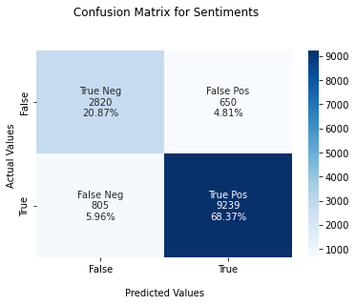
SENTIMENT ANALYSIS ON CUSTOMER REVIEWS
The data was fitted and transformed using logistic regression
The confusion matrix predicts the model to be good at predicting true positives but not as effective while predicting true negatives
These are the evaluation scores for the model
Accuracy : 0.8923338759804647 Precision : 0.8941270239663222 Recall : 0.8923338759804647 F1 score : [0.92700547, 0.794926 ]

Slide 19
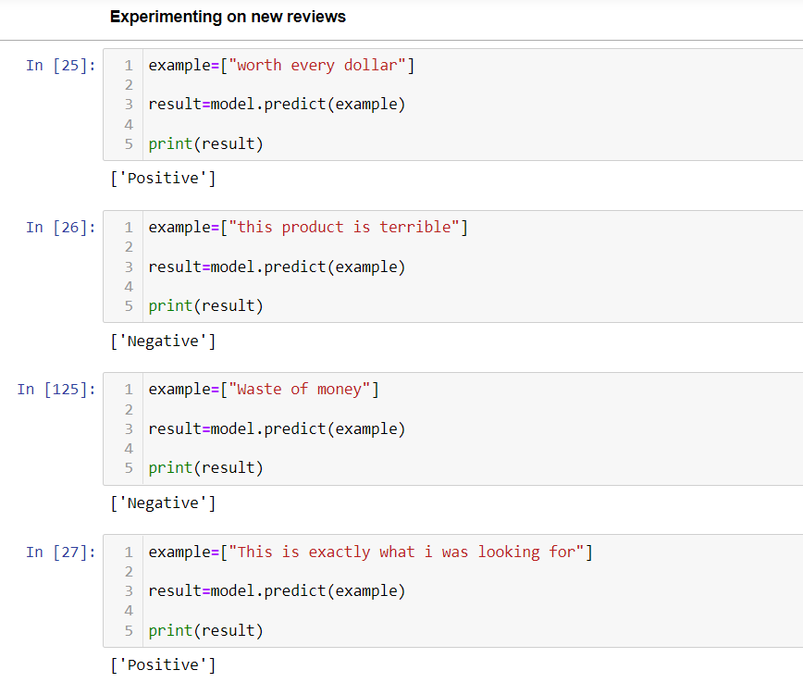
SENTIMENT ANALYSIS ON CUSTOMER REVIEWS

Slide 20
RFM ANALYSIS
RFM analysis is a data driven technique that helps us study customer behavior
It enables the businesses to target specific group of customers with offers and loyalty programs that are tailored to their shopping needs
Thus generating higher rates of response, plus higher sales volumes and customer longevity
The idea is to segment customers based on
When their last purchase was (Recency)
How often they've purchased in the past (Frequency)
How much they've spent overall (Monetary)

Slide 21
APPROACH
In RFM analysis, each customer is rated on three parameters
Recency - The measure of how recently a customer placed order on the website
Frequency - The measure of how many times a customer placed orders from the website
Monetary - The measure of how much does a customer spend on every order
The RFM Approach uses the following formulae to get the Recency, Frequency and Monetary (RFM) values
Recency = Reference date (last day in dataset) — Date of last order
Frequency = Count of orders
Monetary = Sum of purchase values of all orders
Once the customer’s RFM scores are calculated, we use K-Means clustering approach to segregate the customers

Slide 22
RFM SCORING
Based on the RFM values calculated, each customer is given three scores
Recency Score :
1: Recency ≥ Third quartile (Q3) of total time period
2: Second quartile (Q2) of total time period ≤ Recency < Third quartile (Q3) of total time period
3: First quartile (Q1) of total time period ≤ Recency < Second quartile (Q2) of total time period
4: Recency < First quartile (Q1) of total time period
Frequency Score :
1: Frequency ≤ 2
2: Frequency ≤ 4 & Frequency > 2
3: Frequency ≤ 7 & Frequency > 4
4: Frequency > 7
Monetary Score :
1: Monetary < First quartile (Q1) of total range of purchases
2: First quartile (Q1) of total range of purchases ≤ Monetary < Second quartile (Q2) of total range of purchases
3: Second quartile (Q2) of total range of purchases ≤ Monetary < Third quartile (Q3) of total range of purchases.
4: Monetary ≥ Third quartile (Q3) of total range of purchases
These RFM Scores will be the base data that will be used for clustering the customers.

Slide 23
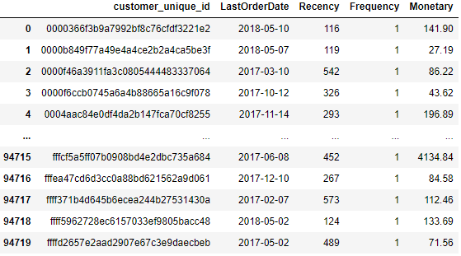
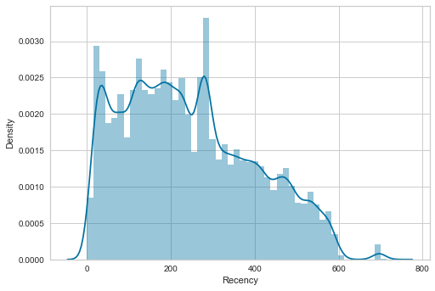
RFM INSIGHTS
Distribution of Recency
Insights:
On an average, the customers placed orders 243 days ago
A customer's average order value was 213 dollars
The average delivery time is 12 days

Slide 24
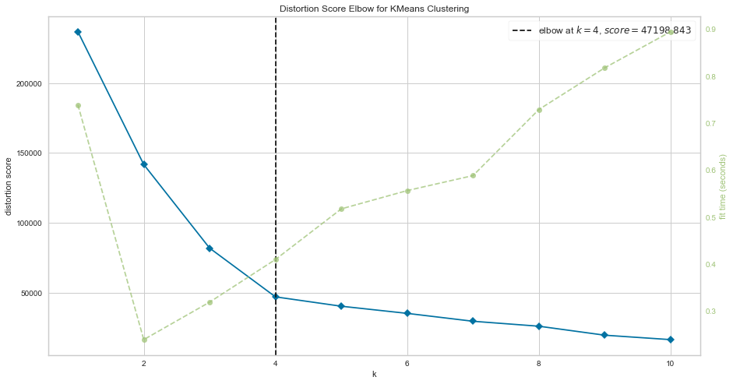
K-MEANS ELBOW PLOT
From the above elbow plot, 4 would be the optimal number of clusters i.e., k=4

Slide 25
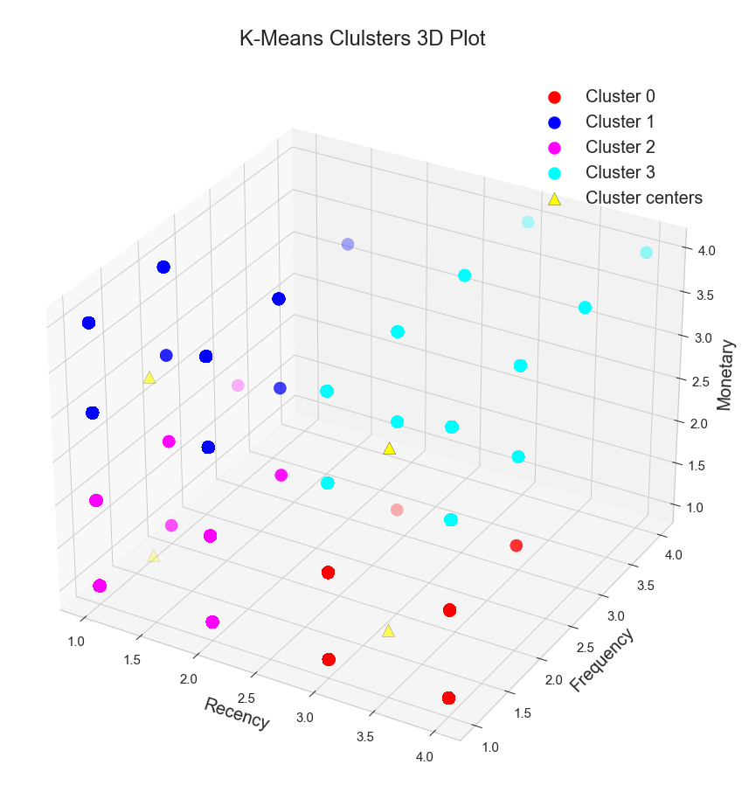
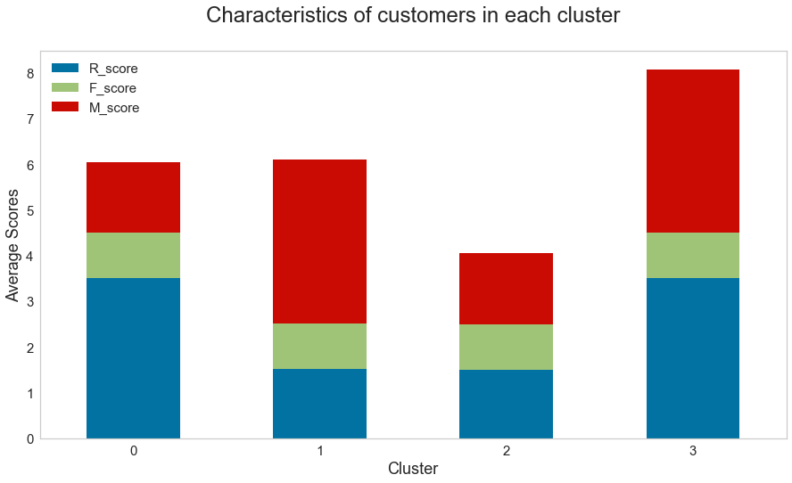
K-MEANS CLUSTERS
Insights:
Cluster 0: New Customers → Higher recency but lower spendings
Cluster 1: High spenders → High purchase value inspite of low recency
Cluster 2: Low spenders → Both low recency and low spending
Cluster 3: Loyal customers → Both higher spending and higher recency

Slide 26
CONCLUSIONS
From the stacked bar graph, F_scores of the customers in each cluster is fairly similar. Hence F_score would be less important when deciding the clusters. The clusters can be seen as customer segments which are as follows
Cluster 0: Early customers with low purchase value
Cluster 1: High spenders
Cluster 2: Hibernating customers with low purchase value
Cluster 3: Loyal customers
The following strategies are recommended for each group
Cluster 0: Giving them great offers and discounts so that they will gain confidence on Olist
Cluster 1: Offering them priority access to promotional offers and discount sale days
Cluster 2: Offering them quality products that are value for their money, so that they will want to buy more from Olist
Cluster 3: Give them both priority access and additional loyalty reward programs as a token of appreciation for their continued trust in the business

